Slide 1
Greedy algo
MST prims and kurskal

Slide 2
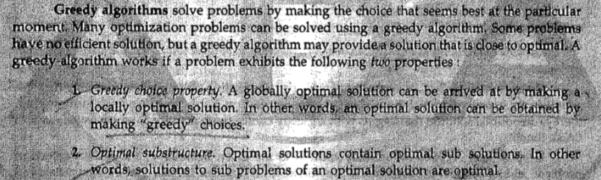
Greedy algo: activity selection problem, knapsack problem : 1(one) or 0(zero), fractional, Huffman code, task scheduling problem, travelling sales person problem

Slide 3
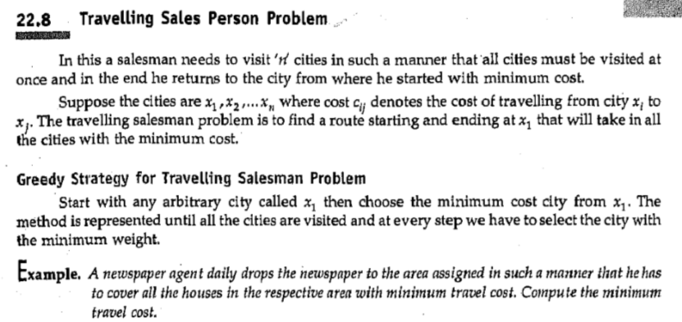
Travelling sales person problem

Slide 4
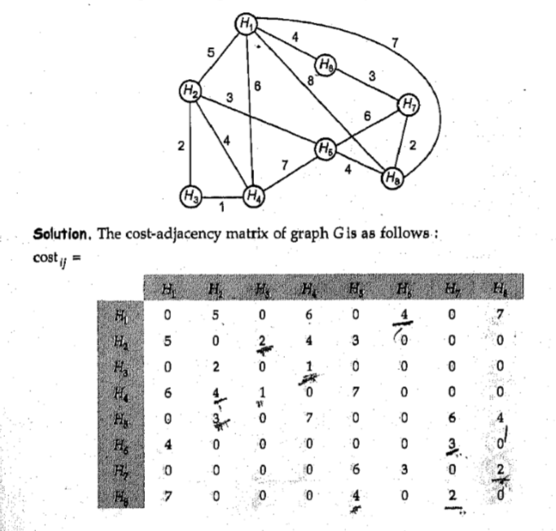

Slide 5
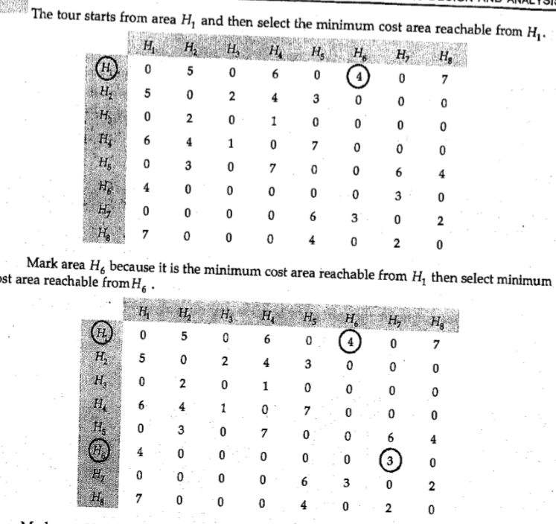

Slide 6
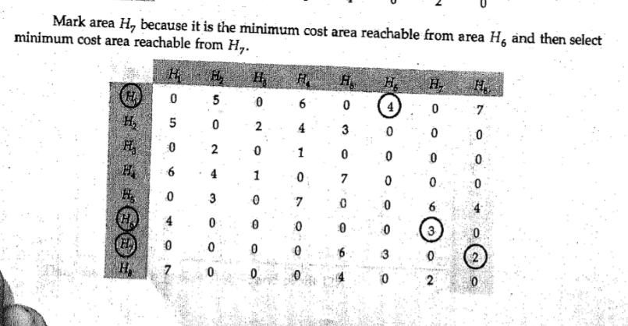

Slide 7
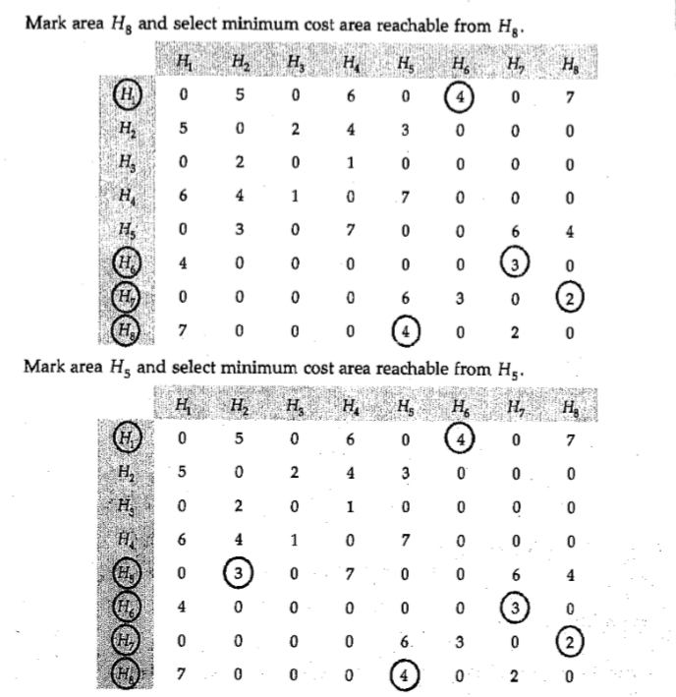

Slide 8
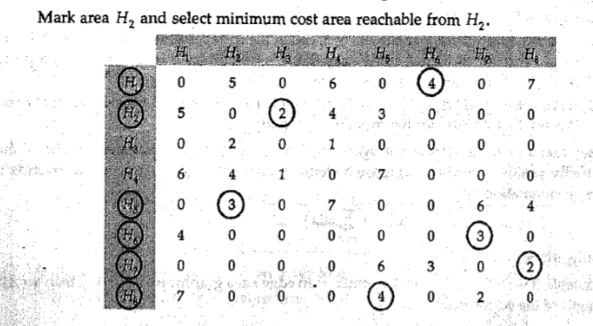

Slide 9
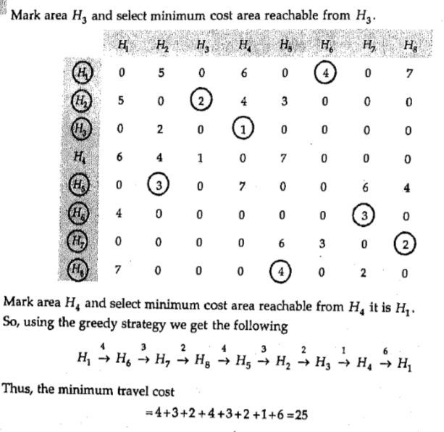

Slide 10
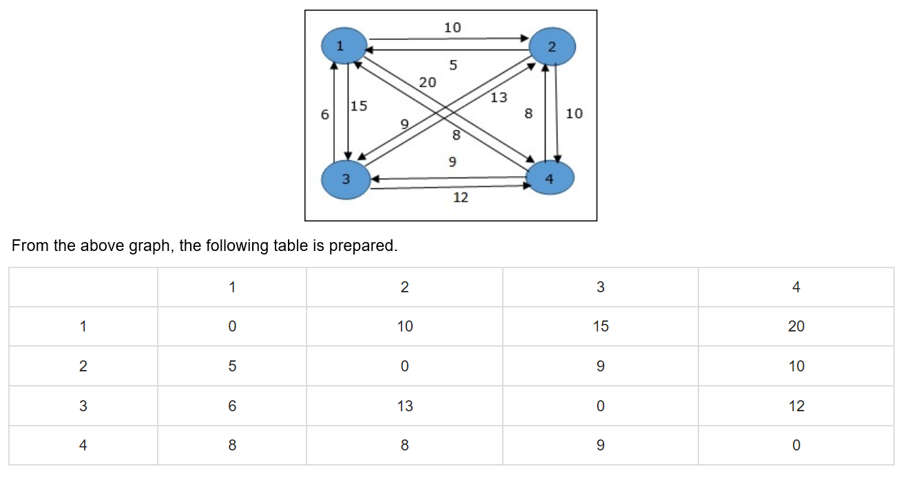
Directed graph

Slide 11
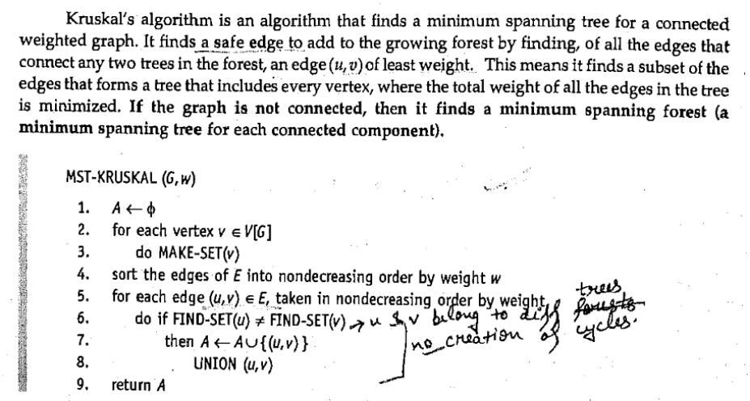
kruskal

Slide 12
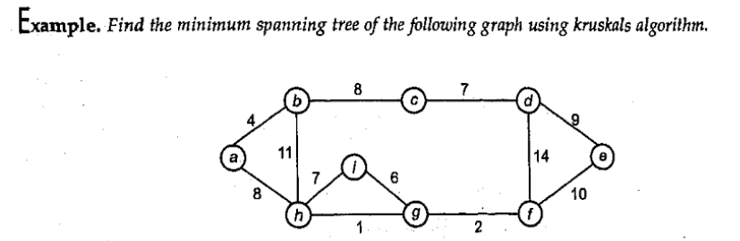
H,g = 1 g,f = 2 a,b = 4 I,g = 6 h, i= 7 c, d= 7 b,c= 8 a,h = 8 d,e = 9 e,f= 10 b,h= 11 d,f= 14

Slide 13
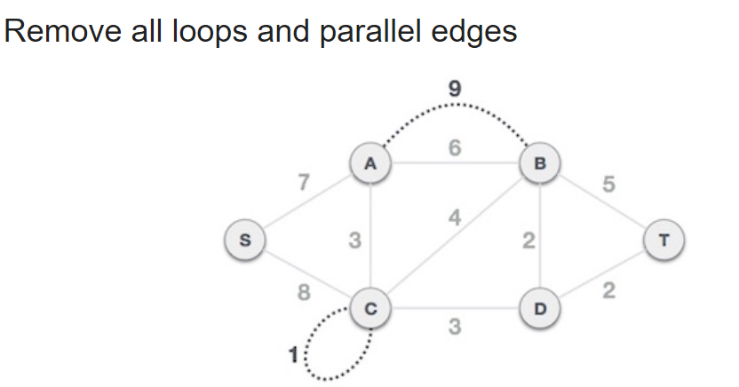
ques

Slide 14
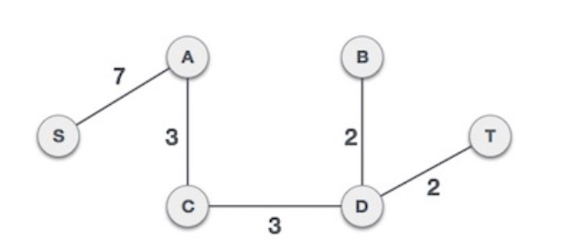
solution

Slide 15
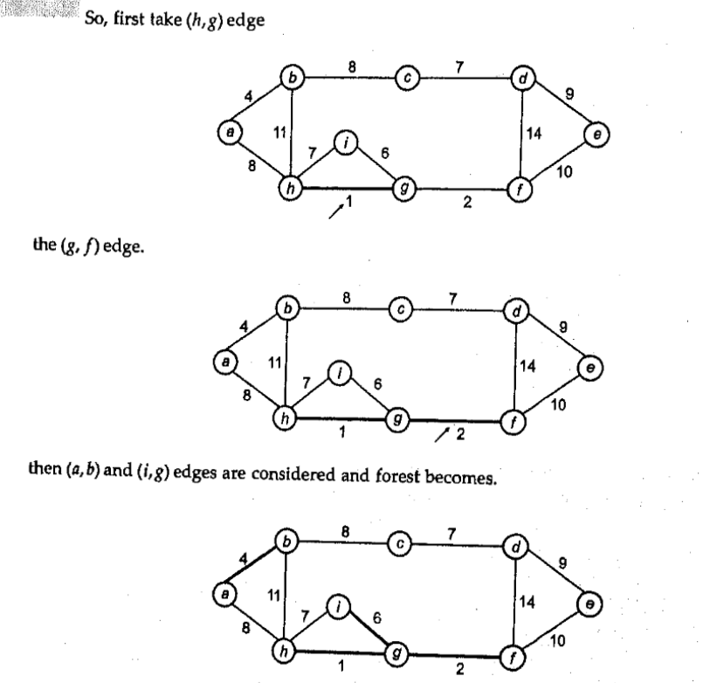
H,g = 1 g,f = 2 a,b = 4 I,g = 6 h, i= 7 (x) c, d= 7 b,c= 8 a,h = 8 d,e = 9 e,f= 10 b,h= 11 d,f= 14

Slide 16
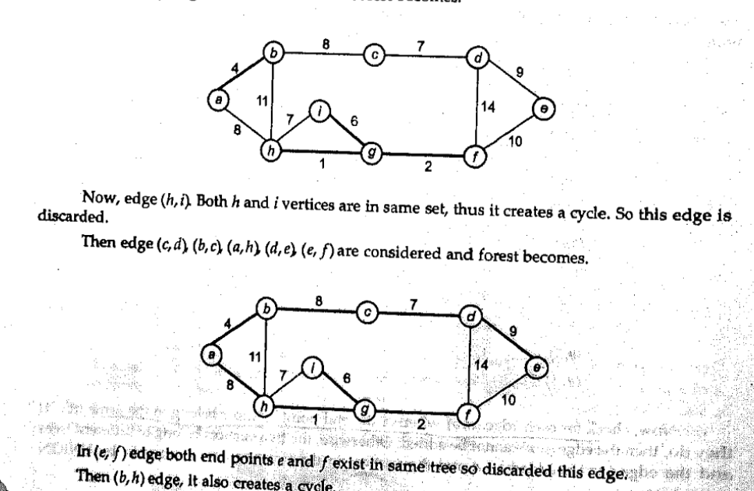
H,g = 1 g,f = 2 a,b = 4 I,g = 6 h, i= 7 (x) c, d= 7 b,c= 8 a,h = 8 d,e = 9 e,f= 10 b,h= 11 (x) d,f= 14 (x)

Slide 17
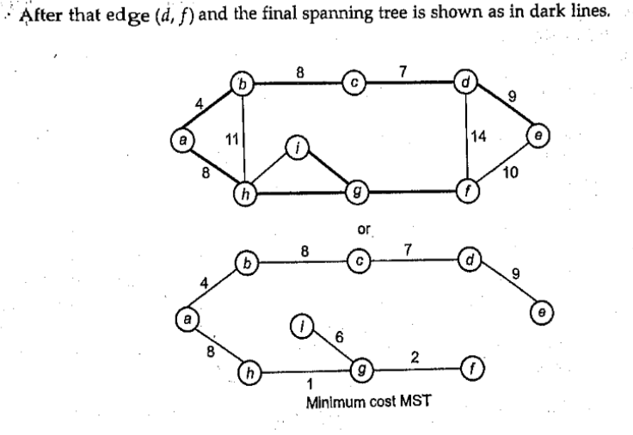
H,g = 1 g,f = 2 a,b = 4 I,g = 6 h, i= 7 (x) c, d= 7 b,c= 8 a,h = 8 d,e = 9 e,f= 10 (x) b,h= 11 (x) d,f= 14 (x)

Slide 18
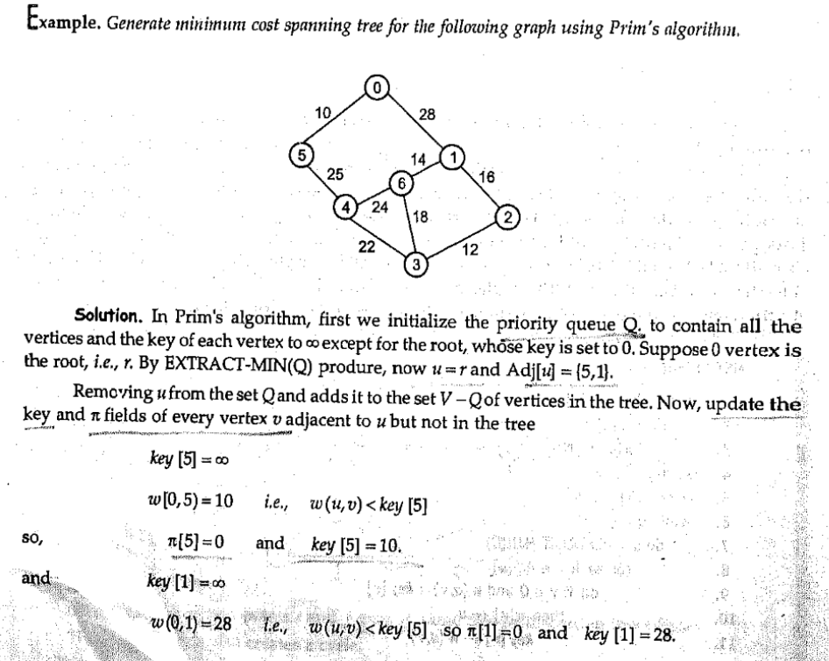
Prim’s

Slide 19
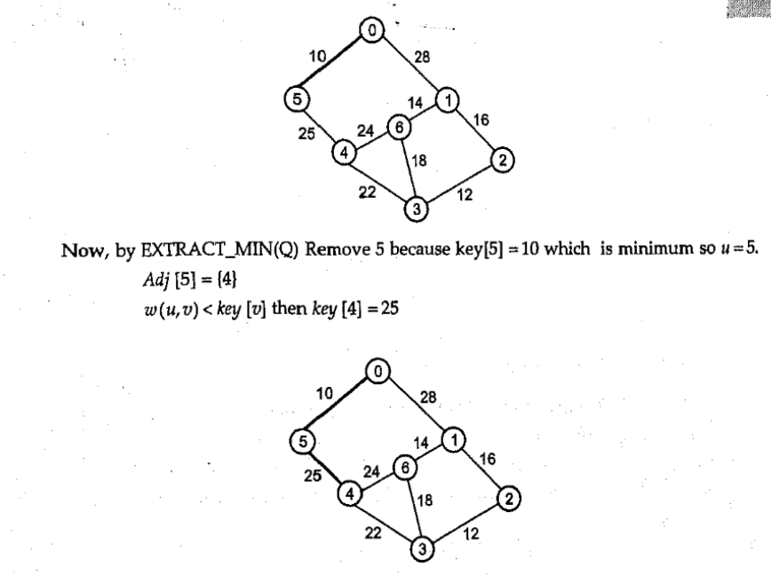

Slide 20
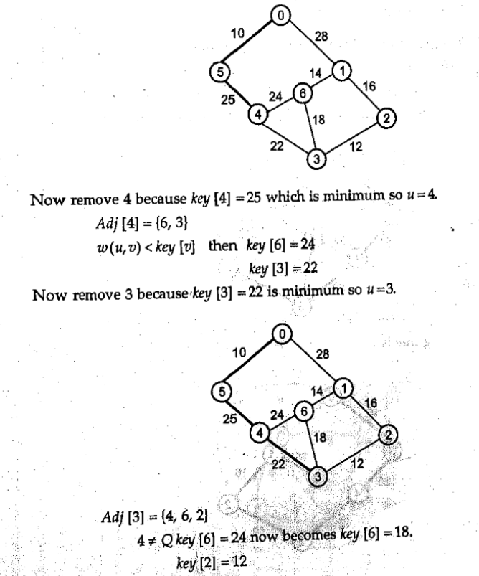

Slide 21
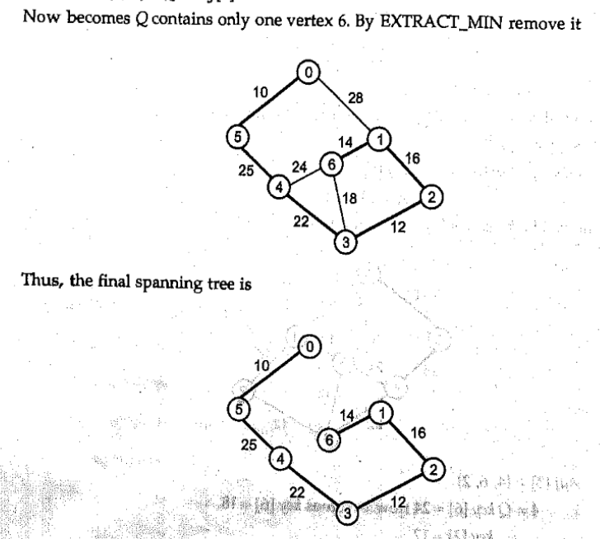

Slide 22
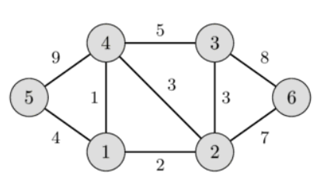
ques

Slide 23
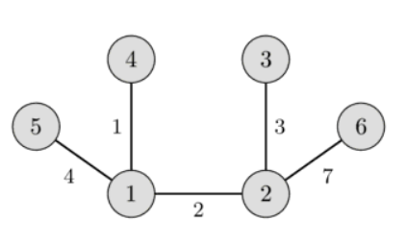
solution

Slide 24
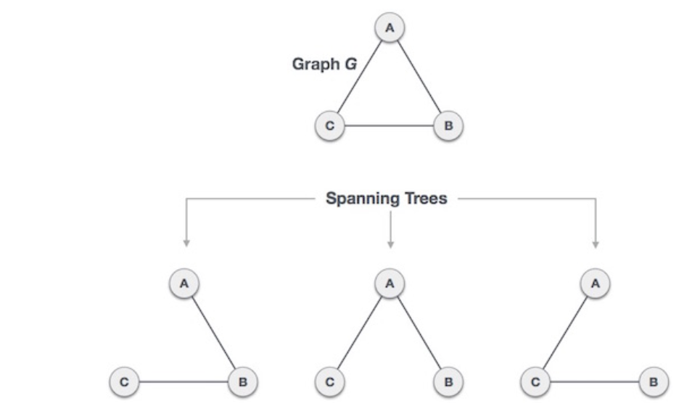

Slide 25
Span tree
16

Slide 26
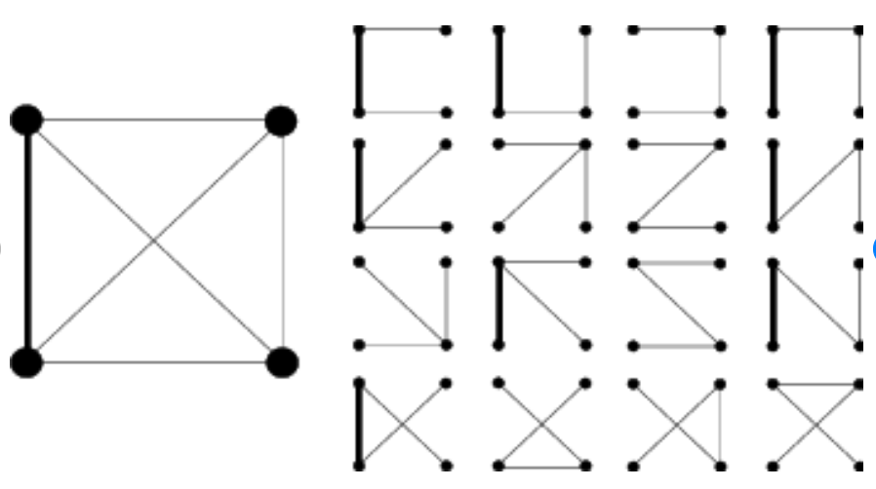
example

